Slide 1

Futurense
Democratizing Tech Talent to deliver impact at scale

Slide 2
OLYMPIC HISTORY
DE SOLUTION
TEAM DATA LAKE
ANIRUDH KURUVA (FT738)
KOUSTAV SARKAR (FT746)
MOKSHA H S (FT750)
SAI VENKAT SEELAM (FT756)
SAKSHI SHINDE (FT757)

Slide 3
Overview:
Brief Description: This project utilizes Olympic data to analyze historical performance, participation, and medal distribution across various countries and sports. It employs HBase with a Sqoop pipeline for data import, AWS S3 Snowpipe for external staging, Azure Copy for additional external staging, and Power BI for data visualization.
Business Problem:The business seeks insights into Olympic performance trends, country-wise medal distribution, and sport-specific achievements. The goal is to provide actionable insights to stakeholders, sponsors, and athletes to inform strategic decisions and investments.
Solution Approach: 1. Data Collection 2. Data Storage 3.Data Staging 4. Data Integration 5. Data Analysis
6. Insights Delivery

Slide 4






Tools and Technologies Used:
Md
Tool 2
Tool 3
Tool 4

Slide 5
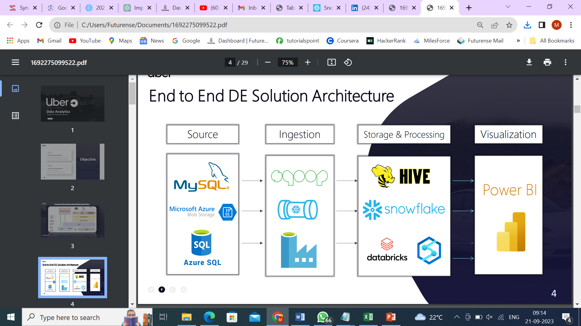
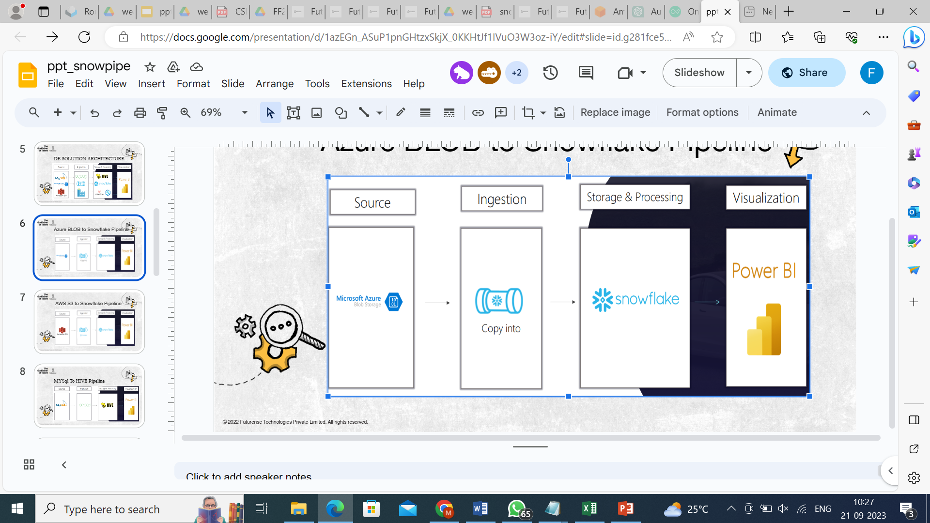


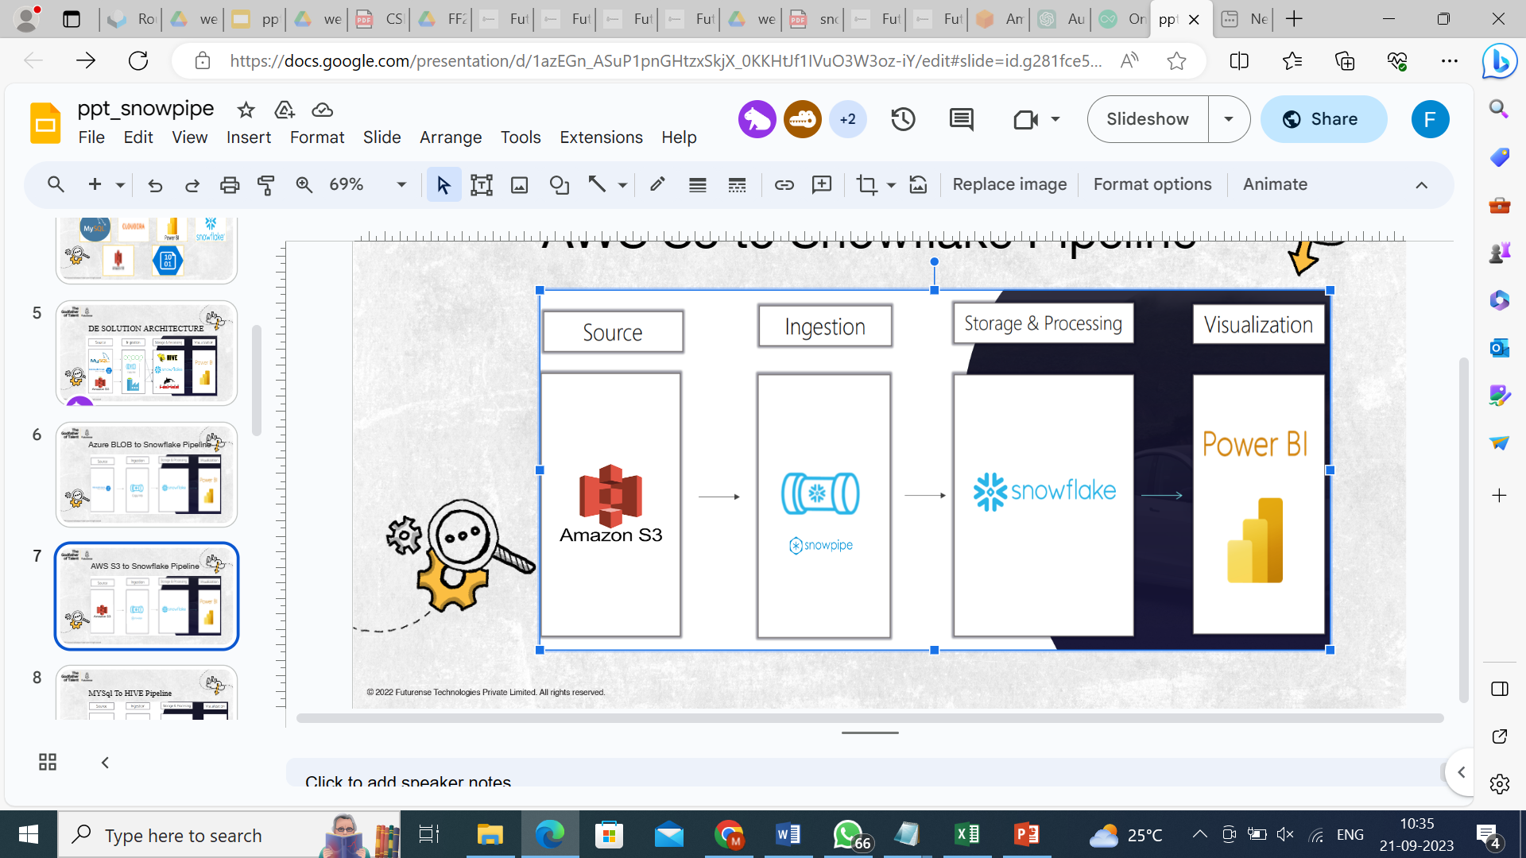
DE SOLUTION ARCHITECTURE
P1
P1
P1
P2
P2
P3
P2
P3
P4
P4
P3
P4

Slide 6
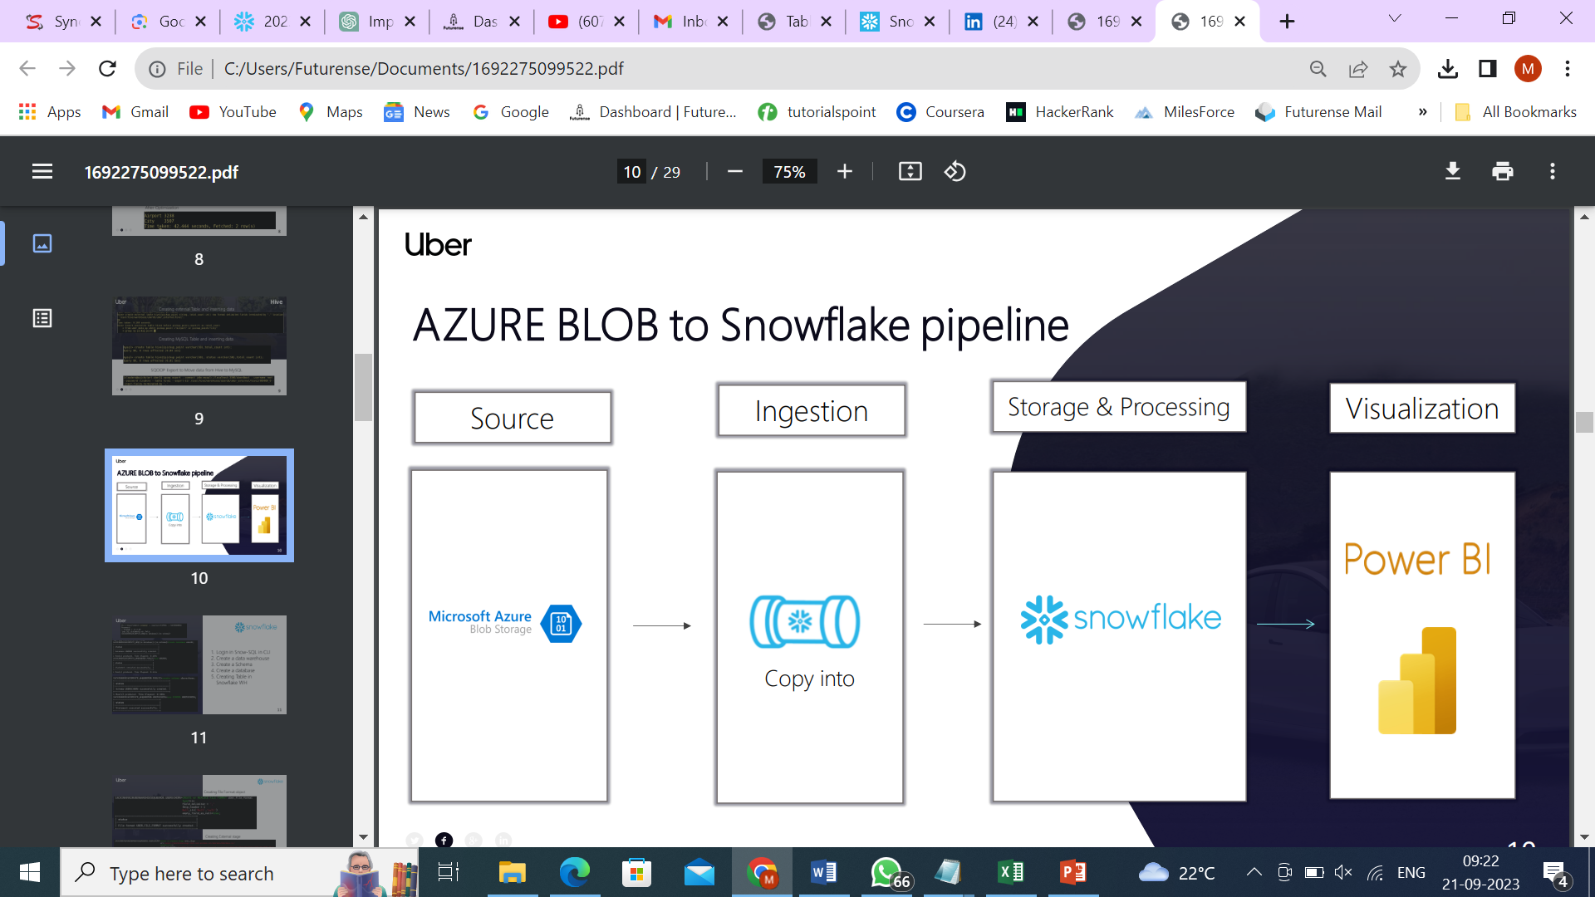
Azure BLOB to Snowflake Pipeline

Slide 7
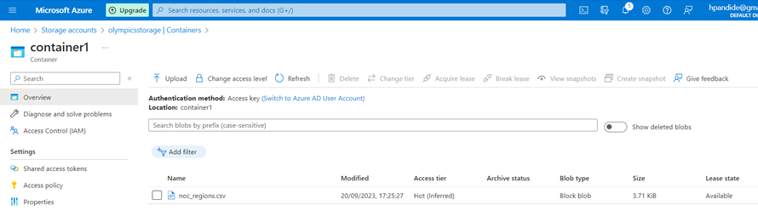
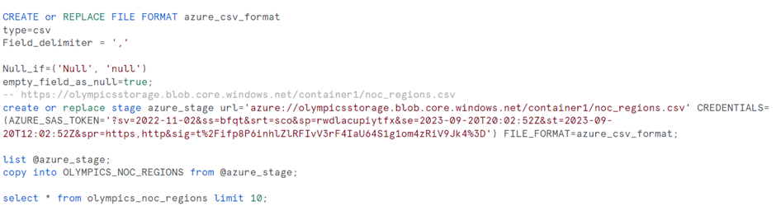
Azure Data input–
External Stage & Copy Into Pipeline –

Slide 8

AWS S3 to Snowflake Pipeline

Slide 9

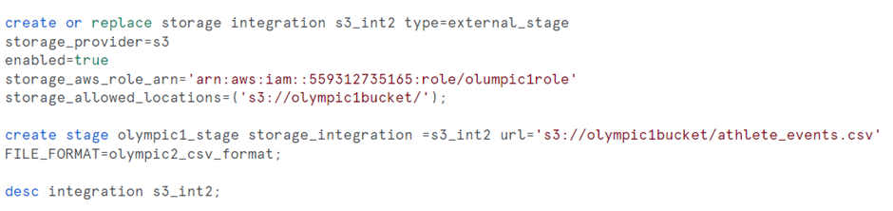
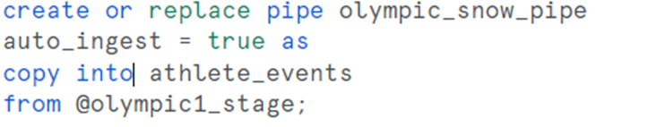

Creating Storage Integration & External Stage for Aws Bucket
Creating Snowpipe for importing from stage

Slide 10
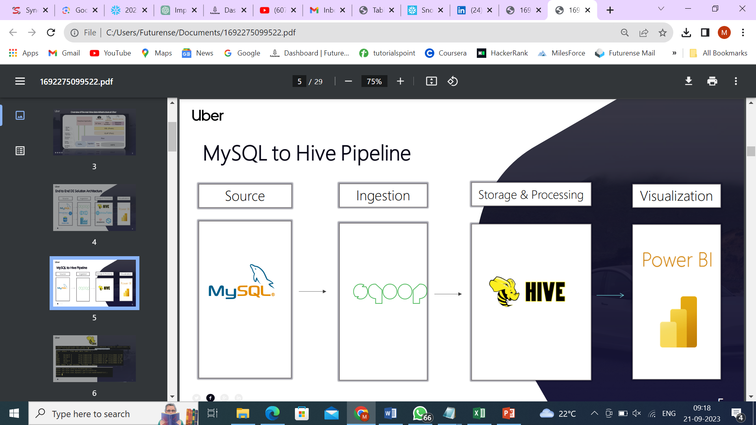
MySQL To HIVE Pipeline

Slide 11
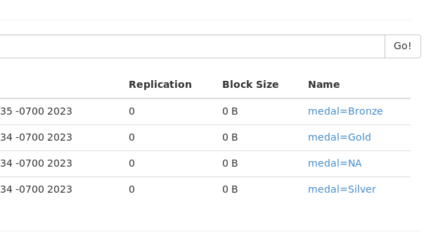
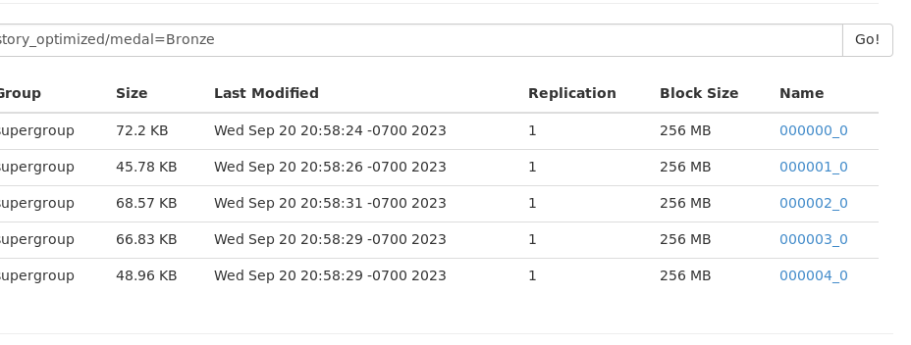
Partitioned Data

Slide 12
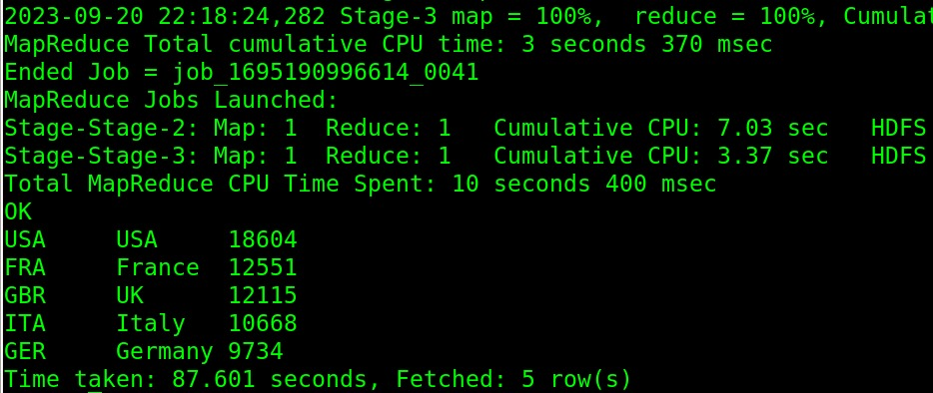
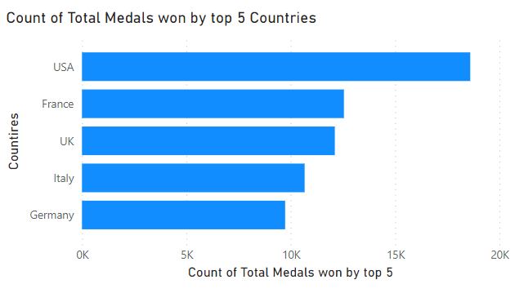
Hive User Story
Fetch the top 5 most successful countries in olympics. Success is defined by no of medals won.

Slide 13
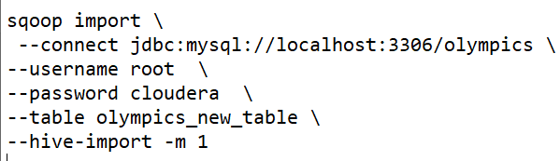
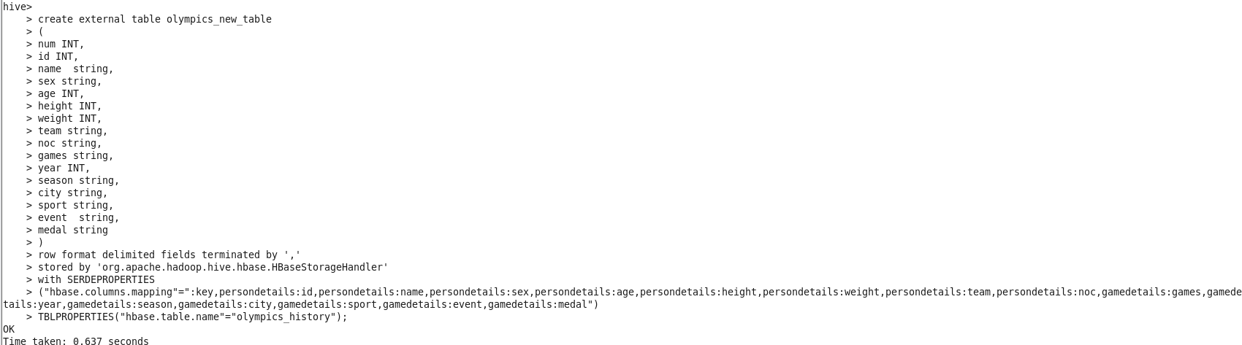
HBase User Story
Importing table from MySQL to Hive & Integrating Hive with HBase

Slide 14
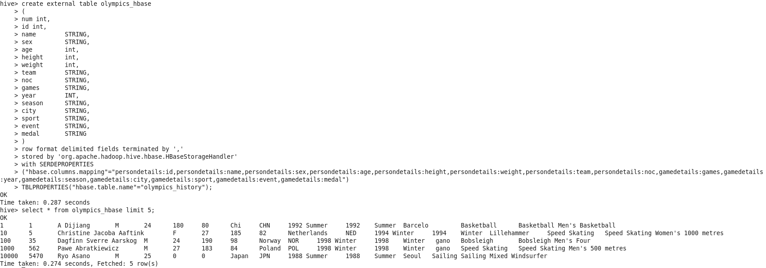
Integrating HBase to Hive

Slide 15
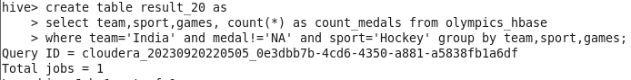
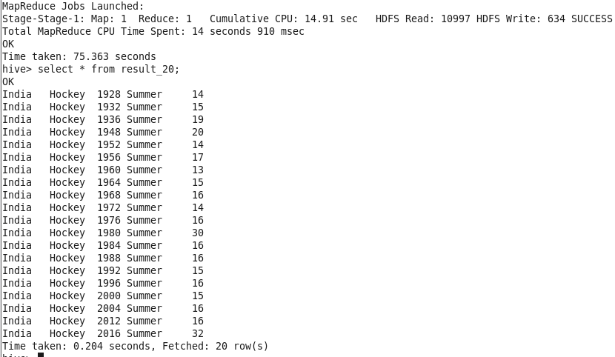
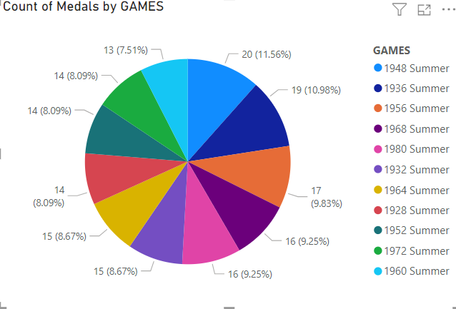
Break down all olympic games where india won medal for Hockey and how many medals in each olympic games.
Output:

Slide 16
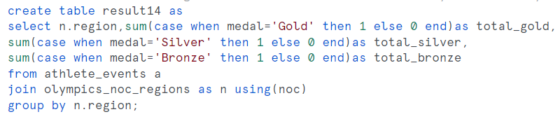
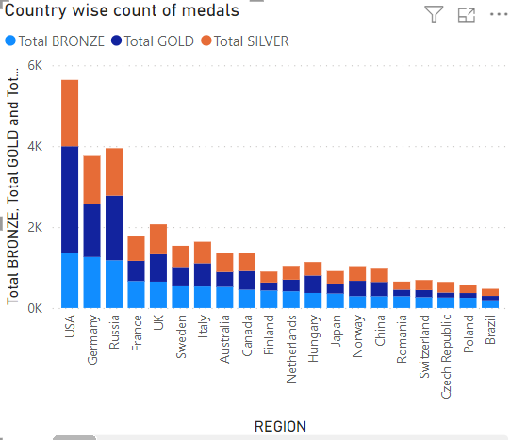
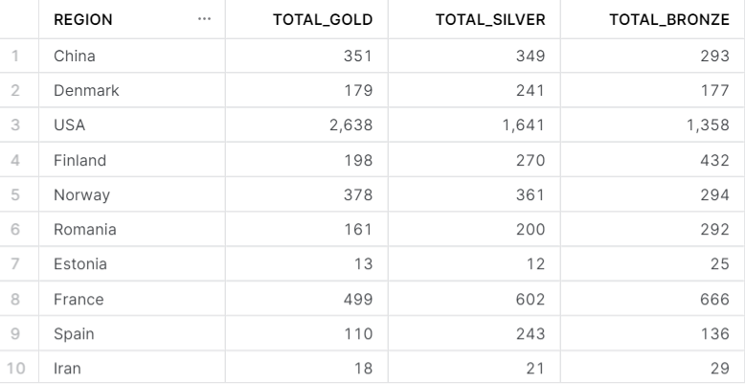
Snowflake User Story
List down total gold, silver and bronze medals won by each country.

Slide 17
Optimizations and Best Practices Used:
> As our solution is dealing with Big Data we have implemented optimizations like Partitioning and Bucketing for hive table for effective data access while analysis.
> We have used ORC file format which will give best compression and performance while analysis.
> Used Map side join while joining NOC_Region table .
> While writing queries we have used Common Table Expression to optimize the query.
> Using external table to store the results as a best practice.
> We have used standard naming conviction as a best practice for readability and understanding.

Slide 18
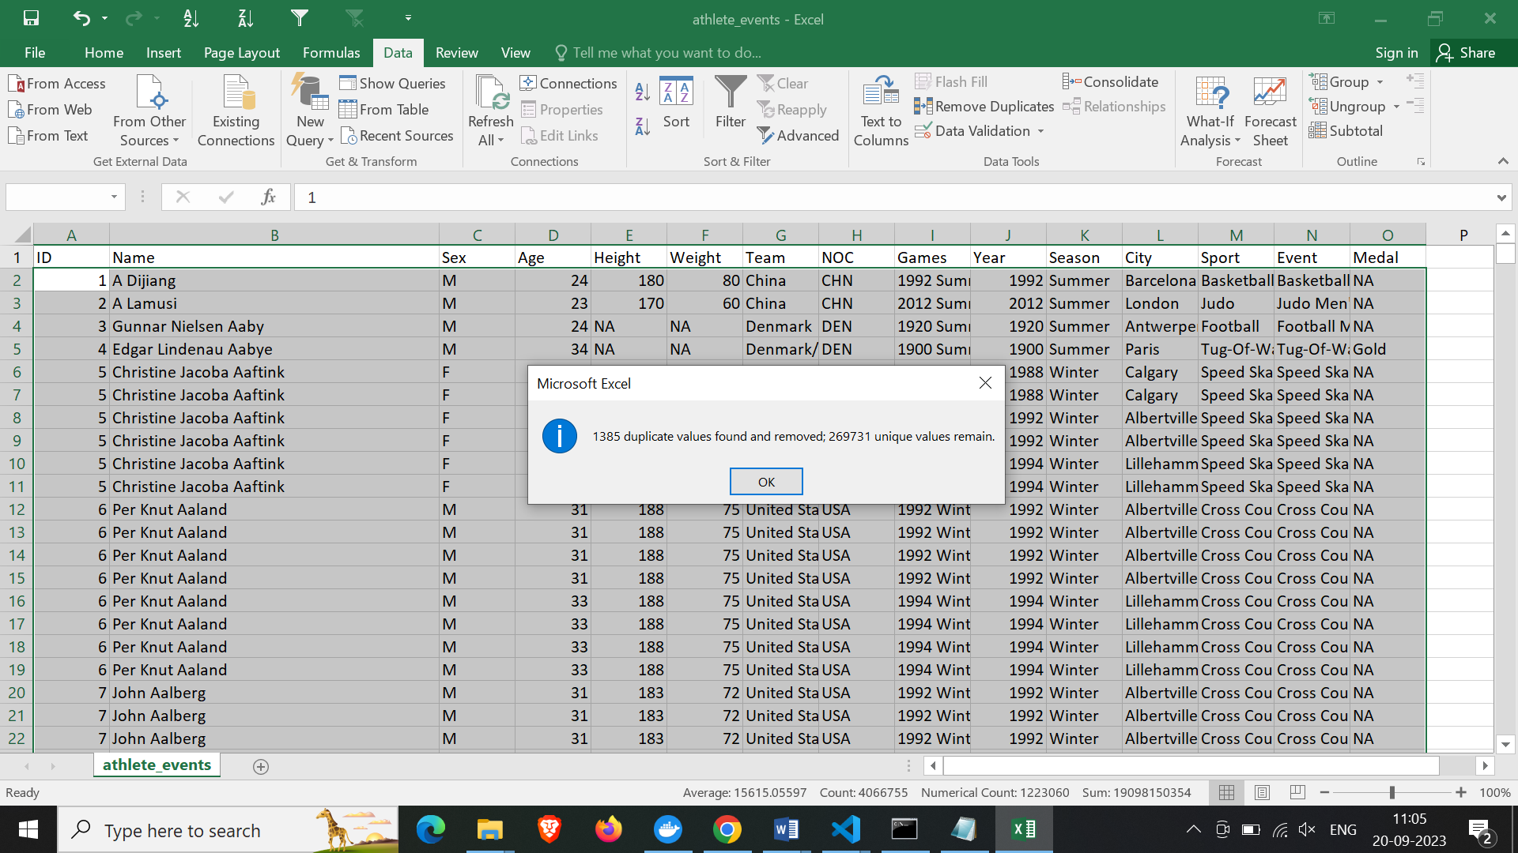
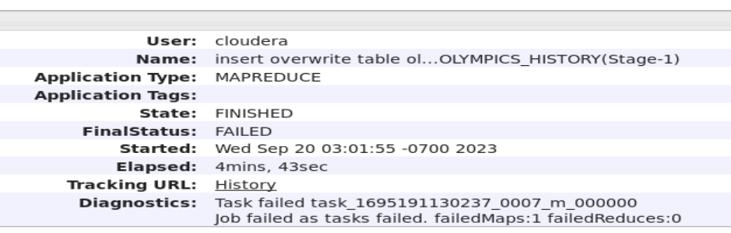
Roadblocks & Resolutions
Roadblock 1:
Data set given has duplicate records and commas in values of particular column.
Resolution 1:
We have removed duplicates and replaced comma as part of cleaning.
Roadblock 2:
As per user stories we have decided to use multiple columns for partitioning and use ORC file format but the we have encountered insufficient heap size error.
Resolution 2:
We can not compresize on fileformat so we have partitioned on best column to be partition.
Snapshots:

Slide 19
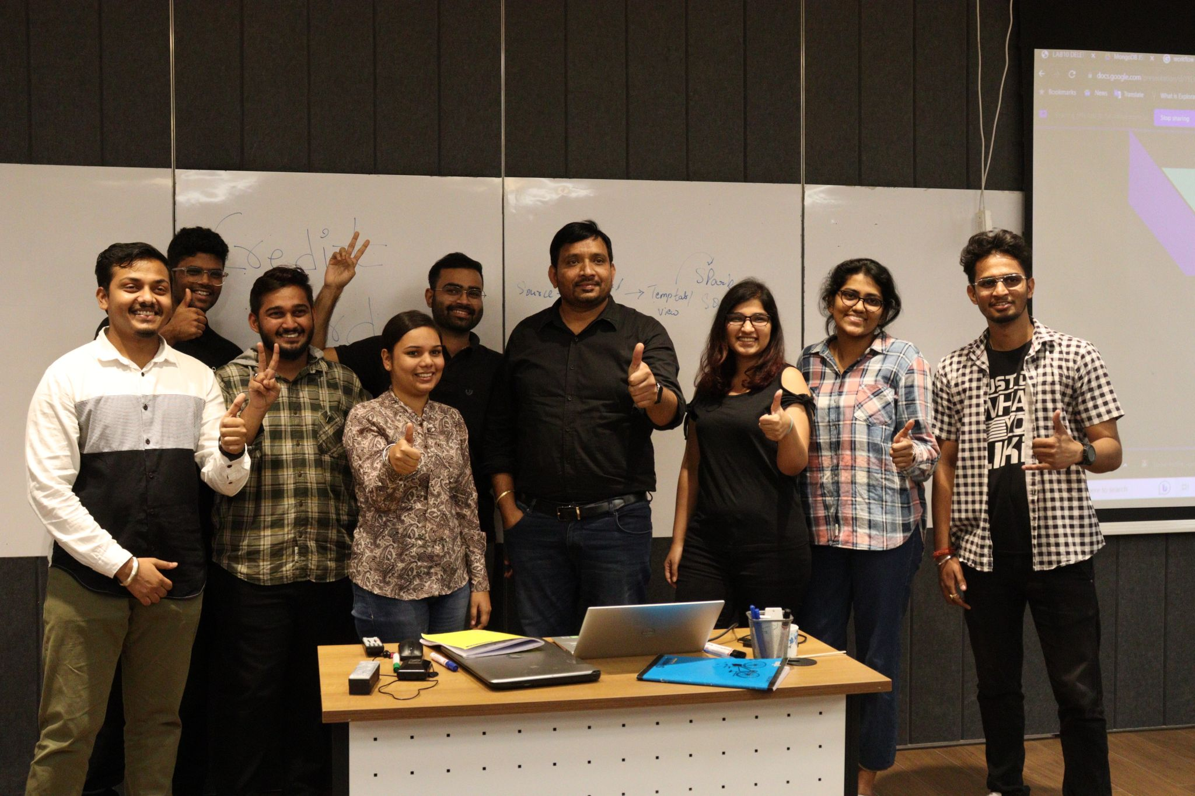
Feedback:
“The concepts we have been taught, hands-on and projects we have done in this learning journey of Big Data made us more confident that we are going to be best Data Engineers thank you sir for valuable technical lessons and also life lessons that you taught us.”

Slide 20
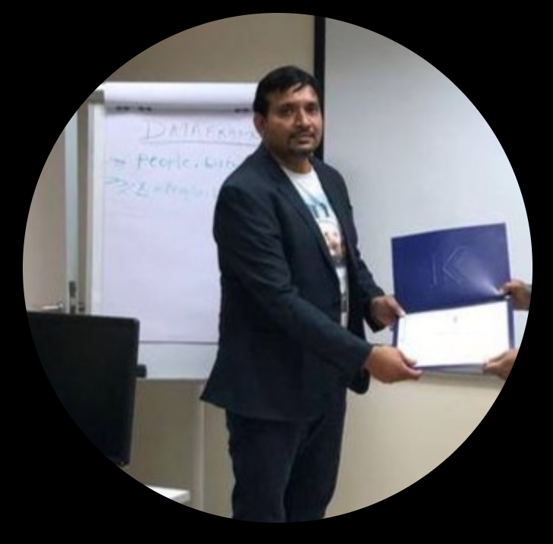





Venkata S Billa, DE Expert
Team Data Lake
Moksha HS
Trainee Data Specialist
Sakshi Shinde
Trainee Data Specialist
Sai Venkat Seelam
Trainee Data Specialist
Anirudh Kuruva
Trainee Data Specialist
Koustav Sarkar
Trainee Data Specialist

Slide 21


